Slide 1
Volunteer Refresher and Re-entry Training

Slide 2
Ombudsman Role and Responsibility

Slide 3
Ombudsman Role and Responsibility
Regular Presence Visits
Schedule visits ahead of time and call facility the day of your visit.
During Your Visit:
Assure that residents have adequate access to posters and brochures that explain the Ombudsman program and provide contact information;
Introduce yourself to residents and talk with them about the program;
Gather information, including whether the residents have any concerns; and
Document your observations.
The resident is always your client.
Notes:
Prior to COVID-19 the LTCOP Policies and Procedures Manual required that you make unannounced visits at intervals that prevent the facility from anticipating your visit.
However, you are now required to schedule visits a head of time and call the facility the day of your visit to check their COVID status.
While visiting the home you are also required to:
Assure that residents have adequate access to posters and brochures that explain the Ombudsman program and provide contact information;
Introduce yourself to residents and talk with them about the program;
Gather information, including whether the residents have any concerns; and
Document your observations.
While you may talk with family members and facility staff during your visits, it is important to keep in mind that the resident is always your client.

Slide 4
Five Categories of Ombudsman Service
Building professional, helping relationships
Provide an opportunity to meet with someone who is not a representative of the facility or a family member;
Provide information and assistance to help residents engage in empowered self-advocacy;
Receiving, investigating and resolving complaints from or on behalf of residents; and
Attending and supporting resident and family council activities.
Notes:
Your activities on visits should complement the five categories of Ombudsman service by:
1. Building professional helping relationships with residents;
2. Providing residents with an opportunity to meet with someone who is not a representative of the facility or a family member;
3. Providing residents with information and assistance to help them engage in empowered self-advocacy;
4. Receiving, investigating and resolving complaints from or on behalf of residents; and,
5. Attending and supporting resident and family council activities.

Slide 5
Documentation

Slide 6
POP QUIZ
Why is documentation for the Ombudsman Program so important?
Notes:
POP QUIZ: Why is documentation for the Ombudsman Program so important?
(allow the volunteers to answer / discuss the question)
Answer: Proceed to the next slide that discusses the importance of documentation.

Slide 7
Documentation
Data gathered:
Helps local, regional, and state programs demonstrate the program is meeting its mandate
Develop programs to target specific areas of concern
Justifies resource and fiscal planning - Data = $$$
Assure continuity of advocacy
Serve as a legal record in a court of law
Notes:
In addition to the responsibilities discussed previously, the Missouri Long-Term Care Ombudsman Program Policies and Procedures Manual requires Ombudsmen to document all activities conducted on behalf of the program.
The data gathered from documentation:
Helps local, regional, and state programs demonstrate the program is meeting its mandate
Develop programs to target specific areas of concern
Justifies resource and fiscal planning. Like they say Data = Dollars
In addition, documentation helps assure continuity of advocacy and may serve as a legal record in a court of law.

Slide 8
Confidentiality

Slide 9
Scenario Discussion
During a facility visit, two residents tell you that they would like to have water available but no one brings it when they ask. They are afraid to ask again and say that it must be an oversight because staff are always rushed. They do not want to complain any more. As you continue your visit, you notice that several other residents who cannot get out of bed do not have water at their bedside tables. Some of the residents cannot communicate with you. You do not see any staff filling containers or distributing water while you are visiting.
How would you handle this situation?
Notes:
Scenario Discussion: During a facility visit, two residents tell you that they would like to have water available but no one brings it when they ask. They are afraid to ask again and say that it must be an oversight because staff are always rushed. They do not want to complain any more. As you continue your visit, you notice that several other residents who cannot get out of bed do not have water at their bedside tables. Some of the residents cannot communicate with you. You do not see any staff filling containers or distributing water while you are visiting.
How would you handle this situation? (Allow for volunteers to discuss how they would handle the situation)
Answer:
Even though the two residents discussed the issues with you but did not give you permission to resolve, you can still open a case (with one complaint) with the Ombudsman being the complainant. You observed numerous residents who are affected by the problem.

Slide 10
Confidentiality
Only way to earn and keep the trust of a resident
Assures that Ombudsman services are resident-directed
Required to have RESIDENTS verbal or written consent
Must obtain RESIDENTS permission to talk with anyone about the concerns
Explain rules to family/friends
Must have the complainant’s permission to be identified
Must have RESIDENTS permission to report back to the original complainant
Notes:
Confidentiality is the cornerstone of your work as an Ombudsman. In many cases, residents of long-term care facilities are afraid that facility staff will retaliate against them if they complain.
Residents and family members who think that you will share their concerns with facility staff without their permission won’t discuss problems with you.
Maintaining confidentiality is the only way that Ombudsmen earn and keep the trust of residents and assure that Ombudsman services are resident-directed.
Chapter 400, Section 404.2(a) of the Missouri Long-Term Care Ombudsman Program Policies and Procedures Manual requires that you have the verbal or written consent of a resident before sharing any information that could disclose the identity of a resident, participant or complainant.
When you open a case, you should work with the resident to identify key individuals such as family members, physicians, or staff who work for the providers whom the resident believes can help resolve the problem. You must obtain permission to talk to anyone else about the resident’s concerns.
From time to time, a family member or friend will call with a concern about an individual in a long-term care facility or in the community. It is a good idea to explain the rules about confidentiality to family and friends who share concerns with you.
You must have the complainant’s permission to be identified. Some individuals prefer to remain anonymous or to not have their identifying information shared.
You must have the resident’s permission to report back to the original complainant.
When you talk to the resident you may find that they would prefer you not share any information about their situation with the original complainant.
You must honor the complainant’s and the resident’s confidentiality.

Slide 11
Confidentiality Contd.
Anonymous Complaints
Explain that facility staff may know by the nature of the concern who filed the complaint.
Explain accessing records will reveal their identity.
Document residents name for your records only.
Be flexible – you may need to come back at another time that wouldn’t alert staff or other residents of your investigation.
Systematic problems – may be able to observe particular issues or gather info from other residents to support opening a case.
Notes:
In a long-term care facility, residents may share concerns with you and ask you to advocate for them as an “anonymous” complainant. In this situation, it is important to let the resident know that you will not disclose any identifying information. However, explain that facility staff may know by the nature of the concern who filed the complaint. You should also explain that any concern that requires you to access records during your investigation will reveal the resident’s identity. For documentation purposes document the residents name however you can proceed with your investigation respecting their wish of remaining anonymous.
Occasionally you will need to identify a resident who is unknown to you and who is not in his or her room. Your approach in this situation will depend on the circumstances surrounding your visit. If you have been told not to approach the resident in a group setting or not to draw the attention of staff, you will need to return at another time. If you are seeking out a resident to discuss a concern or complaint that involves another person who lives or works in the facility, there may be a higher risk of retaliation against the resident because of your visit. In this case, you should return to the facility at a time when the resident is more likely to be in his or her room. On the other hand, if you need to talk with a resident about interactions with an agency or individual from the community, and the resident is unlikely to suffer retaliation from facility staff, it is okay to ask facility staff to help you identify the resident.
If a resident refuses to give you the consent necessary to pursue a case on their behalf and you have reason to believe it may be a systemic problem, you may, without naming the original complainant, ask other residents if they share a similar concern or you may look for activity that supports the anonymous resident’s complaint. If you gather enough information to support opening a case, you may do so, but you must protect the privacy of any resident who does not wish to be identified in your casework.

Slide 12
Empowering Residents for Self Advocacy

Slide 13
POP QUIZ
Are Resident Councils allowed with the limitations that COVID-19 has brought forth?
Notes:
Pop Quiz: Are Resident Councils still allowed with the limitations that COVID-19 has brought forth?
(allow the volunteers to answer / discuss the question)
Answer: Yes. While facilities may consider limitations based on the status of COVID-19 infections in the facility, Ombudsman can still advocate for Resident Councils for residents who have fully recovered from COVID-19, and for those not in isolation for observation, or with suspected or confirmed COVID-19 status. Councils should adhere to the core principles of COVID-19 infection prevention: practice social distancing among residents, appropriate hand hygiene, and use of a face covering.

Slide 14
Empowering Residents for Self-Advocacy
#1 Goal – empower residents
Teach residents how to problem solve
Provide tools needed to improve their own lives
Allows more time for residents who are unable to self-advocate
Notes:
Long-Term Care Ombudsmen are drawn to the program by a desire to help others, especially frail elders. You will often be inclined to solve problems for residents. However, your first goal should be to empower residents to engage in self-directed problem-solving activities. Teaching residents how to solve problems for themselves gives them the tools they need to improve their own lives on a day-to-day basis with minimal assistance from others. By empowering those residents who can help themselves, you will also have more time to devote to residents who are unable to engage in any form of self-advocacy.

Slide 15
Overcoming Barriers to Self-Advocacy
Educating residents about their rights.
Explaining which facility staff can most effectively address specific problems.
Encouraging residents to participate in care plan meetings.
Encouraging residents to participate in resident councils.
Encouraging family members to participate in family councils.
Explaining how to file effective complaints with DHSS
Encouraging residents and family members to call local authorities when there is a medical emergency or a law is being broken in the facility
Notes:
Resident empowerment can only begin when you visit the resident and learn their concerns, the ideas they may have for resolving those concerns, and actions they may have already taken to address the concern.
In the early stages of problem solving, it is appropriate to engage in activities that empower the resident to engage in self-advocacy. Some specific steps you can take include:
Educating residents about their rights.
Explaining which facility staff can most effectively address specific problems.
Encouraging residents to participate in care plan meetings.
Encouraging residents to participate in resident councils.
Encouraging family members to participate in family councils.
Explaining how to file effective complaints with the Missouri Department of Health and Senior Services.
Encouraging residents and family members to call local authorities when there is a medical emergency or a law is being broken in the facility (i.e. rape, assault, theft, financial exploitation).

Slide 16
Overcoming Barriers to Self-Advocacy
Familiarizing Residents with Their Rights
Residents gain rights, not lose
Reinforce this with residents / families
Provide copies of the Residents’ Rights Fact Sheet
Notes:
As you have seen, residents of long-term care facilities do not lose any of their rights when they move into a nursing home. You may find that you need to reinforce this information and teach residents and/or family members about the resident’s new rights to quality of care and quality of life in the facility. It is a good idea to carry several Residents’ Rights Fact Sheets with you on each visit to the facility. The Fact Sheet give you a way to introduce yourself, the Ombudsman program, and the concept of residents’ rights to residents.

Slide 17
Overcoming Barriers to Self-Advocacy
Meeting with Staff Members:
Offer to go along
Do not dominate the conversation
Allow the resident to state their concern and the desired solution
Offer suggestions that can help staff accommodate residents wishes
#1 Goal - Resident Empowerment
Notes:
You can further empower the resident by suggesting that they meet the staff person you have identified as a problem solver. When you suggest this meeting, it can be helpful to offer to “go along.” Your presence can give the resident or representative increased confidence that their concern will be heard and addressed appropriately. If you find yourself accompanying the resident on a meeting with staff, it is important that you not to dominate the conversation. It may be helpful to discuss possible reactions that staff will have to the resident’s request and what approaches to resolution are acceptable to the resident prior to the meeting. When in the meeting, allow the resident to state their concern and the desired solution. If the staff person is resistant to meeting the resident’s goals, it may be helpful for you to offer suggestions that can help staff accommodate the resident’s wishes. Keep in mind that you are there to promote resident empowerment, not to bring the resident’s wishes in line with facility preferences.

Slide 18
Overcoming Barriers to Self-Advocacy
Encouraging Residents to Attend Care Plan Meetings
Assures that resident is getting care that meets their needs
Held regularly AND when a significant change has occurred
May attend at the residents request or with their consent
Help them prepare for the meeting
Direct discussion of issues most pertinent
Problem solving strategy
Notes:
When a care concern arises, Ombudsmen may talk with the resident or the resident’s about arranging a care plan meeting to assure that the resident is getting care that meets both medical and psychosocial needs. Care plan meetings are held on a regularly scheduled basis or whenever there is a significant change in resident condition. Prior to the care plan meeting, representatives of each department in the facility collect information on the resident using an instrument called the Minimum Data Set (MDS). The MDS helps staff identify areas of concern that may need additional intervention. At the time of the meeting, representatives of each department gather to discuss the needs of the resident. Once all interventions are discussed, staff members sign off on the care plan and it is added to the resident’s record. A care plan meeting involves representatives of each department in the facility. The resident and family member should receive a notice whenever a care plan meeting is being held. An Ombudsman may attend a care plan meeting at the request or with the consent of the resident. Sometimes, Ombudsmen attend care plan meetings, serving as a trusted advocate for the resident’s right to self-determination, quality care, and quality of life.
Ombudsmen can help residents and family prepare for a meeting by giving information on how a meeting typically works and helping them practice discussing specific comments, questions, or concerns. Staff generally leads a care conference, but residents, family, and ombudsmen can direct discussion of issues most pertinent to the resident. Ombudsmen may also suggest a care plan meeting as a strategy for resolving a problem.

Slide 19
Overcoming Barriers to Self-Advocacy
Encouraging Participation in Resident or Family Councils
May attend if invited
Assure that their council truly reflects residents' concerns
Staff may facilitate the meeting, not control
Notes:
Another way you may become involved in empowering residents and their family members is through developing, supporting and/or strengthening resident councils and family councils.
One of the ways that you can empower residents and family members is to assure that their council truly reflects their concerns. As an Ombudsman, you may attend meetings at the invitation of a member of the council (a resident or family member, not facility staff). Often you will find that a facility staff member facilitates the resident council meetings and, at least to some degree, controls the topics of discussion in the meetings. You may also find that facility staff takes notes and type up the minutes of the meeting. In some facilities a resident is asked to review the minutes of the meeting before they become official. When staff members control a council meeting or type up minutes that fail to accurately reflect the concerns of council minutes, the council is said to be “compromised.”

Slide 20
Resident Consent

Slide 21
Scenario Discussion
Mrs. Henderson calls with concerns that her mother’s hair has not been maintained during the COVID-19 pandemic. When she went to visit her mother she noticed that her hair had not been cut and had grown to be longer then what her mother usually prefers.
What is the next step the Ombudsman should take?
Note: DHSS issued guidance on barber/beauty shop services in Nov. 20
Notes:
Scenario Discussion: Mrs. Henderson calls with concerns that her mother’s hair has not been maintained during the COVID-19 pandemic. When she went to visit her mother she noticed that her hair had not been cut and had grown to be longer then what her mother usually prefers.
What is the next step the Ombudsman should take? (allow for volunteers to discuss)
Answer: The next step would be for the Ombudsman to speak with the resident to see what she prefers. You may find that she likes her hair longer or you may find that she wishes to have it cut. Either way, your next step is to find out what the residents wishes are and proceed or not accordingly.
Note: DHSS issued guidance in November 2020 allowing facilities to utilize in making decisions about resuming beauty/barber shop services. This guidance does not diminish the responsibility of LTC facilities to safely provide care and services to residents. Each facility will make the final decision to resume services. Facilities should have a policy in place to determine how these activities can be expanded without jeopardizing the health of the residents.

Slide 22
Resident Consent
If a resident:
Refuses to consent – discontinue
Withdraws consent before the complaint is verified – discontinue
Withdraws consent after complaint is verified – discontinue
If reported to law enforcement / other agency may not be able to withdraw the complaint
Ombudsman will need to determine.
Notes:
If the resident:
Refuses to consent to LTCOP work on the complaint then the LTCO shall discontinue work on the complaint.
Withdraws consent before the LTCO has verified the complaint, then the LTCO shall discontinue investigation and resolution activities on the complaint
Withdraws consent after the LTCO has verified or partially verified the complaint then the LTCO shall discontinue investigation and resolution activities on the complaint
If it has already been reported to law enforcement or other agency, the LTCO may not be able to withdraw the complaint. Ombudsman will need to determine.

Slide 23
Resident Consent
When a Resident Withdraws Consent:
Attempt to determine why consent was withdrawn
Let the resident know you are there if they change their mind
Provide business card / contact information
Inform your Regional Ombudsman
Notes:
Sometimes a resident with good decision-making capacity and the ability to understand the consequences of their actions refuses to give, or withdraws, consent to investigate a concern or allegation of abuse or neglect. If this happens:
Attempt to determine why the resident does not want to proceed.
Let the resident know that they can contact the Ombudsman program about concerns at any time in the future.
Be sure to provide the resident with a business card or brochure that provides them with contact information.
Inform your mentor or Regional Ombudsman, especially in cases involving allegations of abuse or neglect.

Slide 24
Resident Consent
Consent and Residents with Diminished Capacity:
Able to communicate with limited capacity and unable to consent
Advocate for the residents wishes to the extent they can express them
Unable to provide any direction
Seek evidence from family / friends
Notes:
Some residents have limited decision making capacity. The Long-Term Care Ombudsman Program Policies and Procedures Manual gives you options for working with residents with diminished decision-making capacity.
If you are working with a resident who can communicate with you in some way but has limited decision making capacity and is unable to provide consent, you should advocate for the resident’s wishes to the extent that the resident is able to express them.
If the resident is unable to direct you at all, you should seek evidence from family, friends, and other sources to try to determine what the resident would have wanted if they were able to direct you. You may then work toward addressing the situation in such a manner that the past values of the resident are actualized. It is always safe to assume that the resident would want his or her health, safety, welfare and rights to be protected.

Slide 25
Investigation and Verification
“The more dependent we are on the mercy of others, the more waiting we have to endure. Dependence and waiting become synonymous.”
Wendy Lustbader

Slide 26
Complaint Investigation
At a minimum, your investigation must include (if allowed by the current pandemic guidance):
A face to face meeting with the resident; and
Direct contact with the complainant.
Notes:
The next step in the Ombudsman problem-solving process is investigation. The purpose of your investigation is to verify the complaint and gather information that will help you resolve concerns.
At a minimum, your investigation must include (if allowed by the current pandemic guidance):
a face-to-face meeting with the resident(s)
direct contact with the complainant either by face-to-face meeting, telephone call or letter (unless the complaint is received from an anonymous complainant, the complainant does not wish to be contacted, or the resident phoned in the complaint and agreed that a face-to-face meeting is not needed).
Ombudsmen often receive complaints from residents while making regular presence visits, therefore you will usually meet the requirements for a face-to-face meeting with the resident during your intake process.
Ombudsmen who receive complaints through phone calls to the program office may ask
Volunteer Ombudsmen to make a face-to-face visit with the resident.
Ombudsmen may also work with the resident on the phone to resolve problems when a resident is facing a facility-initiated discharge due to nonpayment or if the resident has a concern involving a Medicaid application. If you are a Volunteer Ombudsman and become aware of a situation involving a facility-initiated discharge or a question about a Medicaid application note the request in your case notes and let the Regional Ombudsman Program know of the request as soon as possible.

Slide 27
Complaint Investigation (continued)
Complaint investigation may also require you to:
Conduct an unannounced visit to the facility (this may not occur pending the pandemic guidance);
Personally observe the situation;
Interview individuals who may have knowledge of the problem;
Research relevant laws, rules, regulations and policies;
Review pertinent clinical, medical, social, financial records;
Consider if the current problem is part of a systemic concern.
Notes:
Complaint investigation may also require you to:
conduct an unannounced visit to the facility (this may not occur pending the pandemic guidance);
personally observe the situation;
interview staff, administration, physicians, other residents and families having knowledge of the problem;
identify and interview staff from other agencies who have knowledge of the problem or can provide information that would help resolve the problem;
research relevant laws, rules, regulations, and policies for insight into appropriate responses or solutions to the problem;
examine relevant clinical, medical, social, financial and other records as approved by your Regional Ombudsman;
review any other pertinent information that becomes available to you;
consider if the current problem is part of a larger systemic problem in the facility, corporation, agency or program.

Slide 28
Verification
The resident’s perception that a problem exists combined with resident consent to work on the problem allows you to begin the problem solving process.
After you have completed your investigation, you will determine whether the complaint was verified.
Complaints are “verified” if the circumstances described in the complaint were generally accurate.
Complaints are “not verified” if investigation finds that the circumstances described in the complaint were not accurate.
Complaints may be “withdrawn” if the resident requests that you terminate investigation or if the resident dies and no further investigation is required.
Notes:
You are not required to independently verify a complaint before seeking resolution on behalf of a resident. In your role as a resident-directed advocate, the resident’s perception that a problem exists and the resident’s consent to work with you, or to allow you to advocate on their behalf, is all you need to begin the problem-solving process.
Once you have completed your investigation, you will determine whether or not the complaint was “verified.” A complaint is “verified” if the investigation found that the circumstances described in the complaint were generally accurate. A complaint is “not verified” if the investigation found that the circumstances described in the complaint were not accurate.
Complaints may also be “withdrawn” if the resident requests that the investigation be terminated or if the resident dies and no further investigation is required.

Slide 29
Planning, Intervention and Resolution

Slide 30
Scenario Discussion
During your visit at Shady Acres, Mr. Smith tells you that his wheelchair is very dirty and has not been cleaned in a long time. He has mentioned it to the staff however they have not had time to clean it as the facility is short-staffed. Mr. Smith gives you permission to investigate and see what can be done to get his wheelchair cleaned up. You run into the DON in the hallway and report the dirty wheelchair to her. She assures that she will get someone to clean the wheelchair. You then report back to Mr. Smith and let him know that the DON is going to get someone to clean the wheel chair up for him.
Is it ok to proceed with closing this case out?
Notes:
DISCUSSION SCENARIO: During your visit at Shady Acres, Mr. Smith tells you that his wheelchair is very dirty and has not been cleaned in a long time. He has mentioned it to the staff however they have not had time to clean it as the facility is short-staffed. Mr. Smith gives you permission to investigate and see what can be done to get his wheelchair cleaned up. You run into the DON in the hallway and report the dirty wheelchair to her. She assures that she will get someone to clean the wheelchair. You then report back to Mr. Smith and let him know that the DON is going to get someone to clean the wheel chair up for him.
Is it ok to proceed with closing this case out? (Allow for volunteers to discuss)
Answer: No. Ombudsman should follow up with Mr. Smith via phone (if possible) or in person to confirm that the wheelchair was indeed cleaned.

Slide 31
Planning Considerations
Scope and nature of the complaint.
History of the facility with complaint resolution.
Available remedies.
Resources for referral.
Individual or agency best able to resolve the complaint.
Likelihood of retaliation against the resident or complainant.
Possible hidden or “root” problems that may lead to the current concern.
Notes:
When a complaint is verified, you will work with the resident or, if the resident is unable to provide direction, the resident’s representative to develop a plan for resolving the complaint.
When developing the plan of action, consider the following issues:
the scope and nature of the complaint;
the history of the facility with respect to resolution of other complaints;
available remedies and resources for referral;
the individual or agency best able to resolve the complaint; and
the likelihood of retaliation against the resident or complainant.

Slide 32
Planning Considerations
Resident’s desired outcome.
Resident’s willingness to participate in the problem solving process.
Others who may need to be involved in the problem solving process.
Possible solutions.
Objections the facility may have to those solutions.
How you will respond to facility objections?
How you will know when the problem is resolved?
Notes:
Several questions may be helpful as you develop a plan of action:
Is there a “hidden” or “root” problem that is leading to the current concern?
What outcome does the resident want?
Is the resident willing to participate in the problem-solving process? If so, how?
Who else (besides you and the resident) needs to be involved?
What are some possible solutions to the problem?
Of the possible solutions, which one do you want to try first and why?
What objections might the facility (or others) have to your proposed solution?
How will you respond to those objections?
What actions (approaches) will you take to resolve the problem?
How will you know the problem is resolved?

Slide 33
Planning Outcomes
Investigation, verification and planning combine to help identify problem solving approaches that may be available to the resident, including:
No intervention.
An explanation of all remedies available to the resident.
Negotiating an agreement.
Mediating between residents of equal status.
Helping a resident get a fair hearing.
Providing referrals to other appropriate agencies.
Engaging in issue advocacy.
Notes:
The results of your investigation combined with the response of facility staff to the complaint and the satisfaction of the resident with the information gathered during investigation can help you identify a number of problem solving approaches that may be available to the resident.
Once the facts surrounding the complaint have been investigated and the circumstances surrounding the events described in the complaint have been explained to the resident, you may both agree that no further intervention is necessary.
If your investigation verifies that the resident’s or complainant’s concern requires further action, you are required to explain legal, administrative or other remedies that are available to help resolve the problem.
If the findings of your investigation lead to the conclusion that something must change, you may work with or on behalf of the resident to negotiate an agreement with facility staff or other relevant parties to resolve the problem to the resident’s satisfaction. However, you must be careful to never negotiate in a way that will diminish a resident’s rights.
If the complaint involves residents or family members with equal status, you may serve as an impartial mediator to help conflicting parties reach an agreement that resolves the complaint. Because facility staff and family members often have more power than residents, you cannot mediate between a resident and facility staff or family members.
An Ombudsman should never mediate a resident’s rights away. In other words, do not negotiate a settlement that would reduce or minimize the rights of the resident.
You may be instrumental in helping a resident assert their right to a fair hearing in cases of facility-initiated transfer or discharge or when appealing the findings of an investigation conducted by the Department of Health and Senior Services.
You may also coordinate referrals to agencies such as the Missouri Department of
Health and Senior Services and the Centers for Medicare and Medicaid Services, or the Office of Civil Rights. In some cases, you will need to assist the resident by filing a complaint on the resident’s behalf.
If a case requires changes to long-term health care policy or to nursing home standards in order to achieve resolution, contact your Regional Ombudsman to learn how your program engages in issue advocacy.

Slide 34
Intervention
Intervention is simply putting a plan of action to work.
Interventions may include:
Direct advocacy on behalf of the resident.
Contacting your Regional Ombudsman.
Referrals and Joint Investigations.
Referrals to Regulatory Agencies.
Referrals to Legal Services.
Referrals to other Ombudsman Programs.
Joint Investigatory Activities.
Notes:
Intervention is, quite simply putting your plan of action to work. Your interventions on behalf of a resident may include:
Direct advocacy. Unless the resident helps you identify a better problem-solving strategy, your first action step will be advocating on behalf of the resident with the facility staff person or family member who is the source of concern for the resident. To help achieve resident empowerment, it is useful to ask the resident to accompany you to any meetings with facility staff or family members and to give the resident ample opportunity to express their concern in their own terms. It may be necessary for you to encourage facility staff and/or family members to hear the resident out. Once again, you are not mediating in these situations but are serving as a support system for the resident.
Contacting your Regional Ombudsman. Your Regional Ombudsman should be directly involved in complicated cases involving other agencies, legal action or issue advocacy. Having the Regional Ombudsman involved assures that every appropriate means for representing the resident is employed. Many of the advocacy options for these problems require the assistance of a Regional Ombudsman and/or the Office of the State Long-Term Care Ombudsman.
Referrals and Joint Investigations. As a general rule, you will make a referral when:
the resident asks for a referral
another agency offers a service that the Ombudsman program does not offer (i.e. finding housing in the community)
the action to be taken and the complaint is outside of the Program’s authority and/or expertise (i.e., Department of Health and Senior Services or Department Social Services takes enforcement actions); or
an Ombudsman needs additional assistance to achieve resolution of the complaint
Referrals to regulatory agencies. As part of your efforts to empower residents or complainants to engage in self-directed advocacy, you may encourage them to file a complaint with the appropriate regulatory agency. To help assure that complainants file effective complaints, familiarize yourself with and/or refer individuals to the DHSS website https://health.mo.gov/index.php.
Referrals to legal services. If a resident is requesting, or in need of legal advice and representation, the Ombudsman shall assist the resident in finding appropriate legal services.
With consent from the resident or representative, the Ombudsman may make a referral to legal services. If none of these services are able to provide assistance, the Ombudsman may refer the resident or complainant to the local bar association or provide them with a list of at least three private attorneys. An Ombudsman should not recommend an individual private attorney or law practice.
Referrals to other Ombudsman programs. If a resident who is receiving Ombudsman services moves to a different service area they should be referred to the Regional Long-Term Care Ombudsman Program serving that area. The Ombudsman in the receiving service area will follow up with the resident to assure that appropriate Ombudsman services have been received and the original complaint has been resolved.
Joint investigatory activities. At times Ombudsmen are invited to participant in or assist with joint investigations by a regulatory or law enforcement agency.
Remember, your actions are limited by the consent given to you by the resident. However, in some cases, facility staff, family members or other concerned individuals may contact agencies other than the Ombudsman Program to seek remedies. For instance, any individual can file a complaint with the Missouri Department of Health and Senior Services. Family members may also choose to call law enforcement or to seek legal counsel without the involvement of an Ombudsman.

Slide 35
Resolution
There are several possibilities for complaint resolution. These include:
Partially or fully resolved to the satisfaction of the resident, resident representative or complainant.
Withdrawn or no action needed by the resident, resident representative or complainant.
Not resolved to the satisfaction of the resident, resident representative or complainant.
Notes:
When all work has been completed on a complaint and you are ready to close the case, you will need to code a disposition for each complaint. Ideally the complaint is resolved or partially resolved, but there are some instances in which all resources have been exhausted and yet the resident is not satisfied or there is no resolution. Ombudsman will need to follow up with the resident or resident representative to determine the complaint has been resolved and to what level of satisfaction.
01-Partially or fully resolved to the satisfaction of the resident, resident representative or complainant.
02- Withdrawn or no action needed by the resident, resident representative or complainant.
03- Not resolved to the satisfaction of the resident, resident representative or complainant.

Slide 36
Resolution
A case can be closed when:
The complaints are resolved to the satisfaction of the resident.
The complaints cannot be verified or problem solving would not create a satisfactory conclusion.
You do not expect further response from an agency you referred the case to.
The resident asks you to stop working on the problem.
Notes:
A case can be closed when:
when follow up with the resident or representative has been completed;
the complaint has been resolved to the resident’s satisfaction;
you have completed your investigation and determined that the complaint either could not be verified, was not made in good faith or would require additional case work that would not create a satisfactory conclusion, or the complaint is not appropriate for Ombudsman activity;
you do not anticipate any further response regarding the complaint from the agency to which you referred the complaint; or,
the resident has asked you to stop working on the problem.

Slide 37
Q&A
Recap of the Ombudsman Protocol for
Visitation During COVID-19

Slide 38
Ombudsman Protocol
Volunteer Ombudsman may coordinate with their return with their Regional Ombudsman to resume in-person visits.
Notes:
Volunteer Ombudsman may coordinate with their return with their Regional Ombudsman to resume in-person visits.

Slide 39
Q&A
Question: What circumstance may require you to wear gloves and gowns?
Notes:
Question: What circumstance may require you to wear gloves and gowns?
Allow time for volunteers to answer. Answer is on the following slide.

Slide 40
Q&A
Answer:
Gowns and gloves are no longer required to visit residents.
Masks and social distancing are ALWAYS required
Notes:
Answer:
Gowns and gloves are no longer required to visit residents. Masks and social distancing are ALWAYS required.

Slide 41
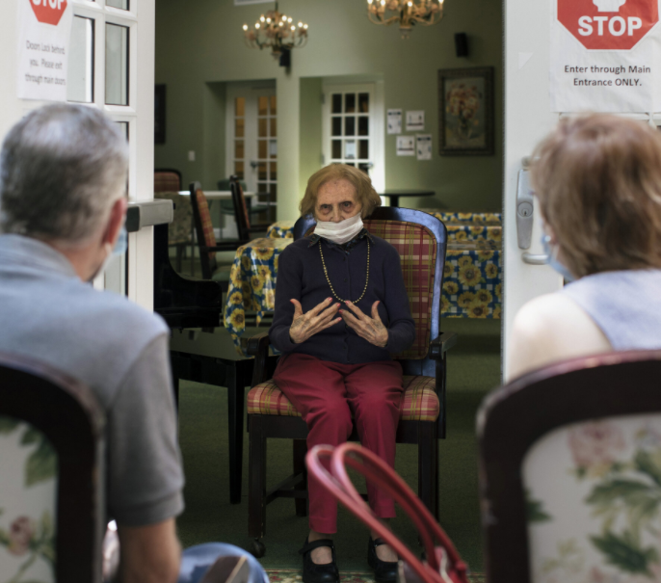
Q&A
Question: What circumstances are required for a long-term care facility to allow indoor visitation?
Notes:
Question: What circumstances are required for a long-term care facility to allow indoor visitation?
Allow time for volunteers to answer. Answer is on the following slide.

Slide 42
Q&A
Answer: All facilities should allow responsible indoor visitation at all times and for all residents, regardless of vaccination status of the resident, or visitor, unless certain scenarios arise that would limit visitation for:
Unvaccinated residents if; 1) the COVID-19 county positivity rate is greater than 10 percent; and 2) less than 70 percent of residents in the facility are fully vaccinated;
Residents with confirmed COVID-19 infection, whether vaccinated or unvaccinated until they have met the criteria to discontinue transmission-based precautions; or
Residents in quarantine, whether vaccinated or unvaccinated, until they have met criteria for release from quarantine.
When a new case of COVID-19 among residents or staff is facility identified, a facility should immediately begin outbreak testing and suspend visitation (except compassionate care visits), until at least one round of facility-wide testing is completed.
Notes:
Answer: All facilities should allow responsible indoor visitation at all times and for all residents, regardless of vaccination status of the resident, or visitor, unless certain scenarios arise that would limit visitation for:
Unvaccinated residents if; 1) the COVID-19 county positivity rate is greater than 10 percent; and 2) less than 70 percent of residents in the facility are fully vaccinated;
Residents with confirmed COVID-19 infection, whether vaccinated or unvaccinated until they have met the criteria to discontinue transmission-based precautions; or
Residents in quarantine, whether vaccinated or unvaccinated, until they have met criteria for release from quarantine.
When a new case of COVID-19 among residents or staff is facility identified, a facility should immediately begin outbreak testing and suspend visitation (except compassionate care visits), until at least one round of facility-wide testing is completed.

Slide 43
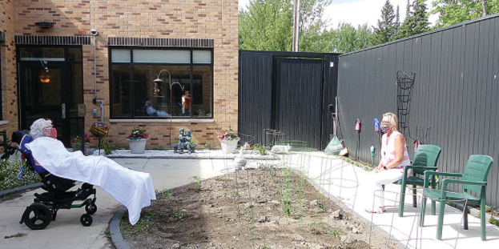
Q&A
What circumstances allow for outdoor visits?
Notes:
Question: What circumstances allow for outdoor visits?
Allow time for volunteers to answer. Answer is on the following slide.

Slide 44
Q&A
Answer:
Per CMS guidance, visits should be held outdoors whenever practicable. However, weather considerations (e.g., inclement weather, excessively hot or cold temperatures, poor air quality) or an individual resident’s health status (e.g., medical condition(s), COVID-19 status) may hinder outdoor visits.
Notes:
Answer: Per CMS guidance, visits should be held outdoors whenever practicable. However, weather considerations (e.g., inclement weather, excessively hot or cold temperatures, poor air quality) or an individual resident’s health status (e.g., medical condition(s), COVID-19 status) may hinder outdoor visits.

Slide 45
Q&A
When should compassionate care visits be allowed?
Notes:
Q) When should compassionate care visits be allowed?
Allow time for volunteers to answer. Answer is on the following slide.

Slide 46
Q&A
Answer:
We note that compassionate care visits and visits required under federal disability rights law should be allowed at all times, for any resident (vaccinated or unvaccinated).
Notes:
Answer: Compassionate care visits should be allowed at all times, for any resident (vaccinated or unvaccinated).
Examples of other types of compassionate care situations include, but are not limited to:
End-of-life situations.
A resident, who was living with their family before recently being admitted to a nursing home, is struggling with the change in environment and lack of physical family support.
A resident who is grieving after a friend or family member recently passed away.
A resident who needs cueing and encouragement with eating or drinking, previously provided by family and/or caregiver(s), is experiencing weight loss or dehydration.
A resident, who used to talk and interact with others, is experiencing emotional distress, seldom speaking, or crying more frequently (when the resident had rarely cried in the past).

Slide 47
Ombudsman Protocol
Working with the facility to coordinate your visit:
Call the facility prior to visiting to verify the facility’s outbreak status.
If the facility has residents currently positive for COVID-19 and they want to talk with the Ombudsman, it should be arranged by phone or device for a virtual visit.
Notes:
Working with the facility to coordinate your visit:
Call the facility prior to visiting to verify the facility’s outbreak status.
If the facility has residents currently positive for COVID-19 and they want to talk with the Ombudsman, it should be arranged by phone or device for a virtual visit.

Slide 48
Ombudsman Protocol
What to do before you visit:
Evaluate personal health for symptoms of sickness
Review guidance on the use of PPE and basic infection control practices.
Review and take a copy of the DHSS Guidance and CMS Visitation Guidance
Notes:
What to do before you visit:
What should you do before your visit to a facility?
Evaluate personal health for symptoms of sickness, including monitoring of temperature. If sick, the Ombudsman should not visit.
Review guidance on the use of face masks, other personal protective equipment (PPE), and basic infection control practices.
Review and take a copy of the DHSS Guidance and CMS Visitation Guidance with you when making your visits to reference if need be.

Slide 49
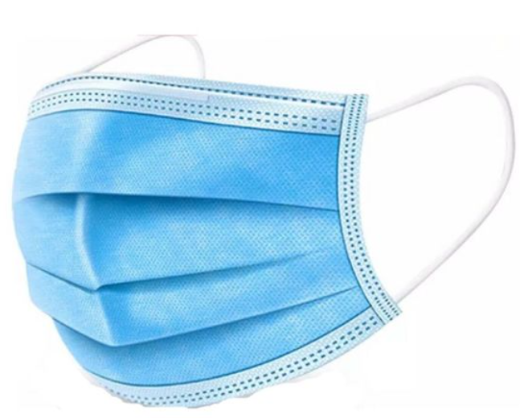
Ombudsman Protocol Q&A
What to do during your visit:
Question: When should you put on a mask?
Notes:
What to do during your visit:
Question: When should you put on a mask?
Allow time for volunteers to answer. Answer is on the following slide.

Slide 50
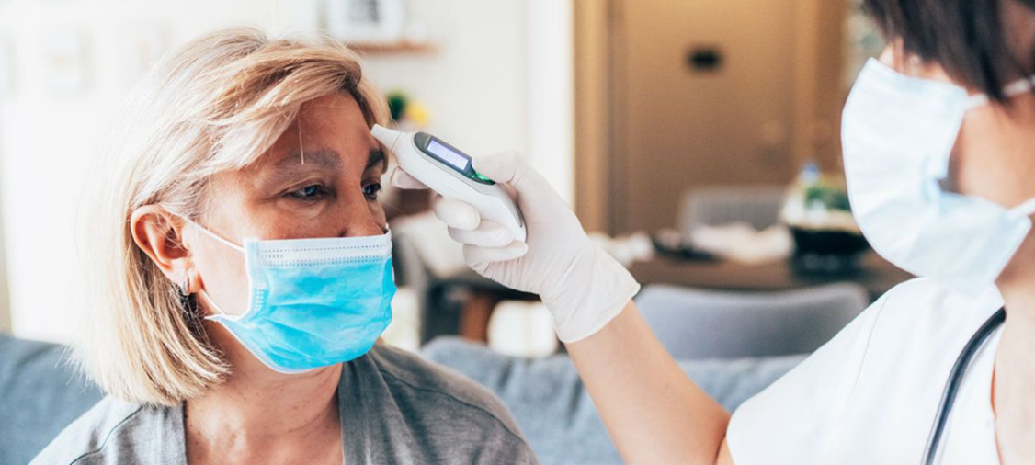
Ombudsman Protocol Q&A
Answer:
Put on a disposable medical mask upon entry into facility
Complete a COVID-19 screening with facility staff upon entry into the facility
Notes:
Answer: Put on a disposable medical mask upon entry into a long-term care facility.
Complete a COVID-19 screening with facility staff upon entry into the facility.

Slide 51
Ombudsman Protocol Q&A
Question: What should you take with you inside the facility?
Notes:
Question: What should you take with you inside the facility?
Allow time for volunteers to answer. Answer is on the following slide.

Slide 52
Ombudsman Protocol Q&A
Answer:
Only bring necessary items into the facility
Wipe down items brought into the facility with a disinfectant wipes.
Always wear a disposable medical mask and refrain from touching or adjusting the mask.
If the mask must be touched or adjusted, hand hygiene through using hand sanitizer or hand washing should be done immediately before and after touching.
Use hand hygiene
either the use of hand sanitizer or hand washing for at least 20 seconds – before and after entry into each facility and each resident room.
Notes:
Answer:
Only bring necessary items into the facility to reduce spreading germs.
Wipe down items brought into the facility with a disinfectant wipe before and after the visit.
Always wear a disposable medical mask within the facility and refrain from touching or adjusting the mask. If the mask must be touched or adjusted, hand hygiene through using hand sanitizer or hand washing should be done immediately before and after touching.
Use hand hygiene – either the use of hand sanitizer or hand washing for at least 20 seconds – before and after entry into each facility and each resident room.

Slide 53
Ombudsman Protocol Q&A
Question: How much physical distance should you maintain from staff, residents, and other visitors?
Notes:
Question: How much physical distance should you maintain from staff, residents, and other visitors?
Allow time for volunteers to answer. Answer is on the following slide.

Slide 54
Ombudsman Protocol Q&A
Answer: Always maintain physical distance of at least 6 feet from staff, residents, and other visitors.
Notes:
Answer: Always maintain physical distance of at least 6 feet from staff, residents, and other visitors.

Slide 55
Ombudsman Protocol
Recap of PPE Guidance
Clean your hands with soap and water, or hand sanitizer, before touching the mask.
Hand Sanitizer:
Should contain at least 60% alcohol.
Apply product to the palm of one hand in the correct amount, per the directions on the bottle.
Rub your hands together, all over the surfaces of your hands and fingers until your hands are dry, which should take around 20 seconds.
Notes:
Recap of PPE Guidance:
Clean your hands with soap and water, or hand sanitizer, before touching the mask.
Hand sanitizer should contain at least 60% alcohol. Apply the gel product to the palm of one hand in the correct amount, per the directions on the bottle. Rub your hands together. Rub the gel all over the surfaces of your hands and fingers until your hands are dry, which should take around 20 seconds.

Slide 56
Ombudsman Protocol
Question: Is it ok to touch the front of your mask?
Notes:
Question: Is it ok to touch the front of your mask?
Allow time for volunteers to answer. Answer is on the following slide.

Slide 57
Ombudsman Protocol Q&A
Answer:
AVOID touching the front of the mask
Only touch the ear loops / ear ties / ear bands.
If the surgical mask has ear loops – hold and unhook both ear loops and gently lift the mask away from your face.
Holding the mask only by the ear loops / ear ties / ear bands, dispose of the mask in the trash.
Clean your hands with soap and water, or hand sanitizer again, before touching anything else.
Notes:
Answer: AVOID touching the front of the mask, because it is contaminated. Only touch the ear loops / ear ties / ear bands.
If the surgical mask has ear loops – hold and unhook both ear loops and gently lift the mask away from your face.
Holding the mask only by the ear loops / ear ties / ear bands, dispose of the mask in the trash.
Clean your hands with soap and water, or hand sanitizer again, before touching anything else.

Slide 58
Ombudsman Protocol Q&A
Question: Is reusing surgical masks appropriate?
Notes:
Question: Is reusing surgical masks appropriate?
Allow time for volunteers to answer. Answer is on the following slide.

Slide 59
Ombudsman Protocol Q&A
Answer:
DO NOT reuse surgical face masks.
Notes:
Answer: No. DO NOT reuse surgical face masks.

