Slide 1
CREATING HOLIDAY JOY IN THE SHADOW OF A PANDEMIC
November 12, 2020
1– 2pm CT

Slide 2
WELCOME!
Marjorie Moore
Executive Director

Slide 3
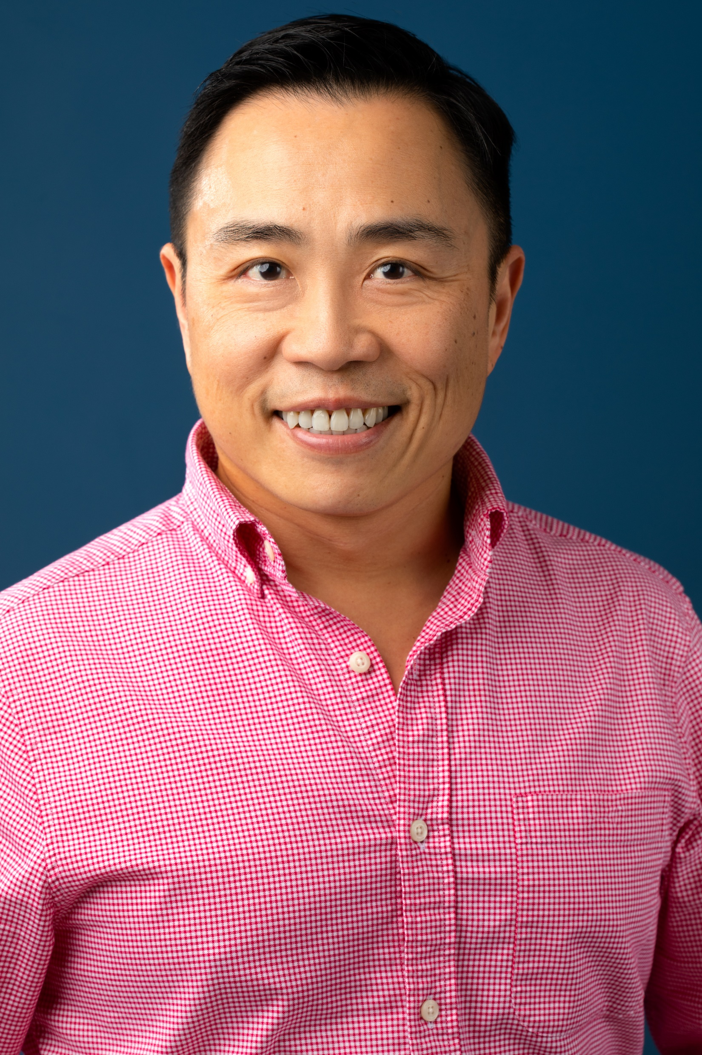
Chien Y. Hung MSW, MA-G, RYT
Program Director
LTC Ombudsman Program
VOYCE
314 919 2411
chung@voycestl.org

Slide 4
The Shadow…
Isolation, loneliness, fear, boredom (routine: same place, same time, doing same thing, or same nothing…), malaise (lack of motivation), depression
Seven types of loneliness:
1. New-situation loneliness 5. No-time-for-me loneliness
2. I’m-different loneliness 6. Untrustworthy-friends loneliness
3. No-sweetheart loneliness 7. Quiet-presence loneliness
4. No-animal loneliness
Holiday blues

Slide 5
Visitation Guidance
CMS (9/17/2020)
https://www.cms.gov/files/document/qso-20-39-nh.pdf
DHSS (9/22/2020) https://health.mo.gov/living/healthcondiseases/communicable/novel-coronavirus/pdf/visitation-guidance.pdf

Slide 6
Joy!
Virtual Caroling
Each household picks a song and everybody takes turns performing
OR one group calls all other groups individually to simulate going door to door
Zoom Dinner
Don’t forget to set place settings for your socially distanced guest!
Set up the phone/laptop and connect them to Zoom while you eat
Consider making individual serving(s) of favorite dishes and desserts to drop off to your loved one so they can share the same meal
Secret Santa
Use a free gift drawing app (searchable on Google) to draw names
Mail or drop off your gift to your recipient
On your holiday’s day, open them all together on the phone or Zoom

Slide 7
Joy!
Socially Distanced Movie Watching
Everyone picks the same movie and streams at the same time!
You can call each other and hear each other’s reactions, simulating watching the movie in the same room
12 Days of Christmas/8 Nights of Hannukah gift/card giving
Holiday coloring pages and crafts

Slide 8
Joy!
Holiday Baking/Cooking
If you can’t all be together on your holiday day, have smaller group days to celebrate
Make a different treat or meal with each group. Be sure to write down the recipe and take pictures to share with the others!
Also, you can film your baking experience in a mock “cooking show” to send out!
Cookie Competition “Iron Chef, Thanksgiving!” – Thanks for the example, Meaghan!
From Meg’s family: have separate groups of “bakers” and “judges”
Bakers pay an entry fee (optional)
Each baker makes a batch of their winning cookie! On the Holiday, judges retire to a separate room to rank the cookies. Winner takes all the cash!
To make it socially distanced:
Smaller groups of bakers and judges. Score the cookies on a scale of 1-10. Winning cookies from each group are “finalists” and compare scores to determine overall winner
To include loved on in LTC: make them the judge! Drop off one of each cookie entry and let the loved one pick the winner.

Slide 9
Joy!
Game Shows
The Price is Right – Thanksgiving Edition
Guess the price of popular Thanksgiving items!
20 lb turkey
Can of cranberry sauce
Ingredients for pumpkin pie
A small pumpkin
Add in your family’s favorite decorations and treats!
Can be done via Zoom or create a “catalog” of items and have participants mail in their guesses
Jeopardy! Holiday Edition (https://jeopardylabs.com/play/holiday-trivia)
Create an Excel “board” of various holiday trivia
Keep a separate list of corresponding questions

Slide 12
Joy!
Facility Activities
Holiday Decoration Tour
Winter Wonderland – in small groups or show video
Winter Wonderland at Tilles Park: drive through and carriage rides available
AB Brewery Lights: on foot
Way of Lights (Our Lady of the Snows): 6 and 10 person carriage rides are available
Garden Glow at Botanical Gardens: On foot, they have special family and bargain nights
Santa’s Magical Kingdom at Six Flags Eureka: train/wagon takes you through
Wild Lights at the Zoo: Looks like on foot
Holiday Movie Watching
Sing-a-Long / Caroling

Slide 13
Joy!
These might be helpful — Thanks for the tips, Libby! —
https://www.saintlouisgalleria.com/en/events/virtual-visits-with-santa-34873.html
Virtual Santa
https://www.christmaslightfinder.com/search/
Christmas light finder: you put in your zip code, and it tells you what neighborhoods have Christmas light displays. These are those light displays that individuals do, usually syncing it with music and often done a whole street participates, so they're free and usually really cool!
https://www.kastapp.co/
Kast: this is a free app that syncs the show, movie, etc., that you are watching with someone virtually. The app has voice and video chat functions as well, so you can chat while you watch tv. Libby uses at least once a week to watch tv with a friend, and she loves it! Imagine a Netflix party only much better because you can talk to the other person while watching, and you can watch more than Netflix.

Slide 14
Be Mindful…
Don’t forget social distancing, hand washing, and PPE while planning and enjoying the holiday activities!
https://www.stltoday.com/news/local/govt-and-politics/st-louis-health-board-recommends-limiting-home-gatherings-to-10-people/article_88821891-dffe-588b-8ffe-29ccb21c340e.html
Coordination, communication, and verification ASAP
Be thoughtful. Activities need to be interactive and inclusive
Friendly games are not for competition; they are for validation
What happens after the holidays?!

Slide 15
After-Holiday Blues
1 out of 17 Americans aged 65+ suffer from some form of depression
Seniors aged 65+ account for 20% of all suicide deaths in the United States
Approximately 68% of Americans aged 65 and over know little or nothing about depression

Slide 16
Post-Holiday Approach…
Make friends & form new connections and networks inside and outside of LTC facilities (AAA, church, App)
Volunteer
Take up a new hobby (mentally and physically) annually
Adopt a pet (Reminder: An animal is a commitment & responsibility)
Reminisce (Life review will help recall the aspects of life that matter to you. Research shows that people who reminisce enhance emotional health and are less likely to be lonely or withdrawn. “Reorganizing old photos and adding descriptions to them” being one of the activities)
Gratitude practice (meditation), help others, ask for help
Look out for signs of depression and dementia
Live your life with structure, not pattern

Slide 17
Q & A
Chien Y. Hung
314 919 2411
chung@voycestl.org
Program Director
LTC Ombudsman Program

